Slide 1

IMPLEMENTING STANDARDS
KEYS TO SUCCESS
Implementing Standards
Bob Cornacchioli
get2bobc@gmail.com
http
Bob Cornacchioli
get2bobc@gmail.com
www.derotechnical.com

Slide 2

Understanding Common Language
Constraints and “Givens” in PowerSchool
Best Practices- Standards are Coming!
Importing Standards using Excel
Grade Scales
Looking at PTP
Report Card options
Agenda/Participants will be engaged in:
All PPT can be found @
www.derotechnical.com

Slide 3

Your concerns…

Slide 4






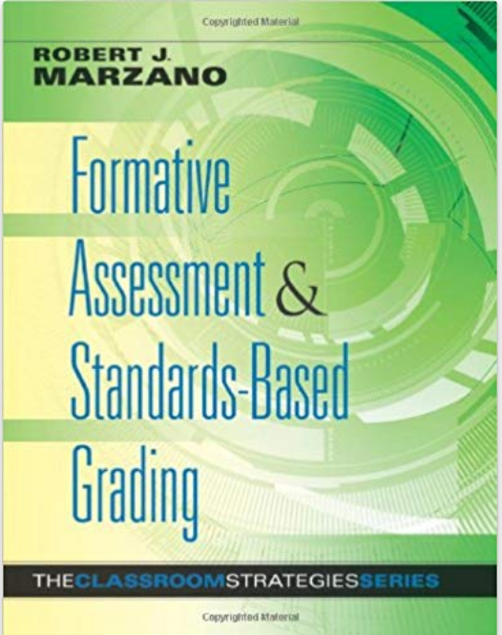
STANDARD BASED GURU’s
(I’m not)
Rick Wormeli
Tom Guskey
Susan Brookhart
Ken O’Connor
Tom Schimmer
Jane Bailey
Robert Marzano

Slide 5




CEO - DERO Technical Services (2007)
Marketing/- ParkBench Software Trainer (2007)
PSISJS Partner – Standards/Trainer (2013)
Alpha/Beta Team for PS and PTP
Bob Cornacchioli
Director of Technology and Media Services
Shrewsbury Public Schools (16 yrs.)
PowerSchool Administrator (6 yrs.)

Slide 6
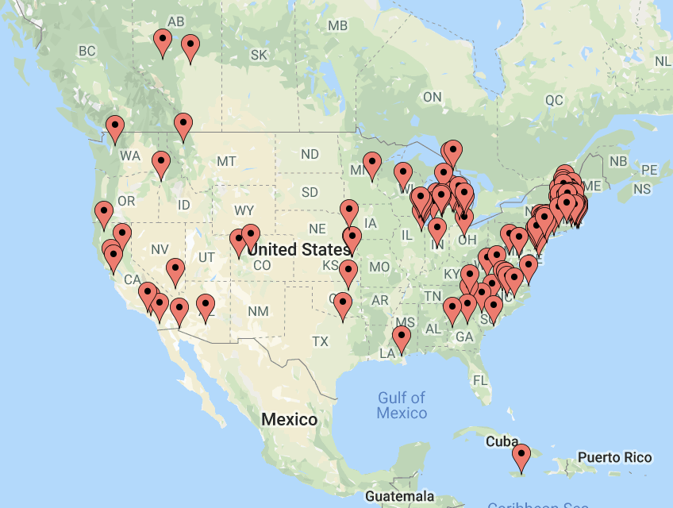
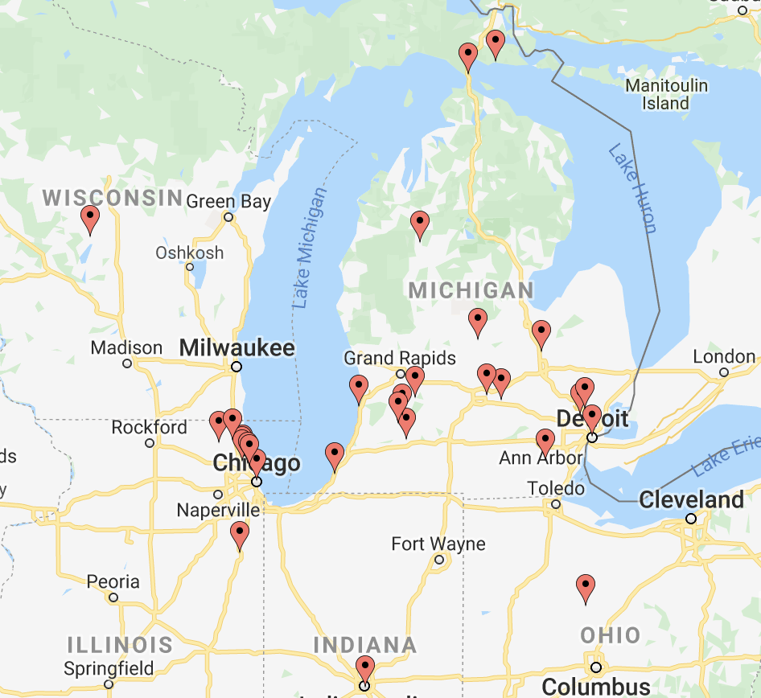
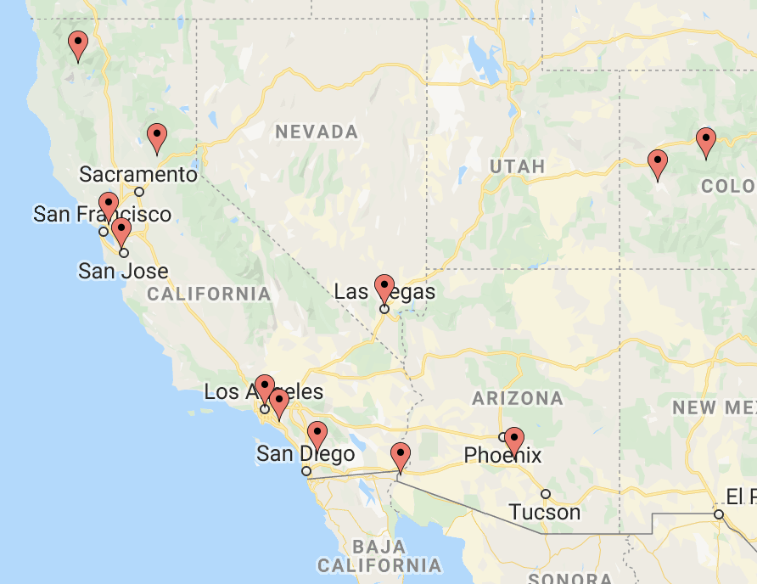
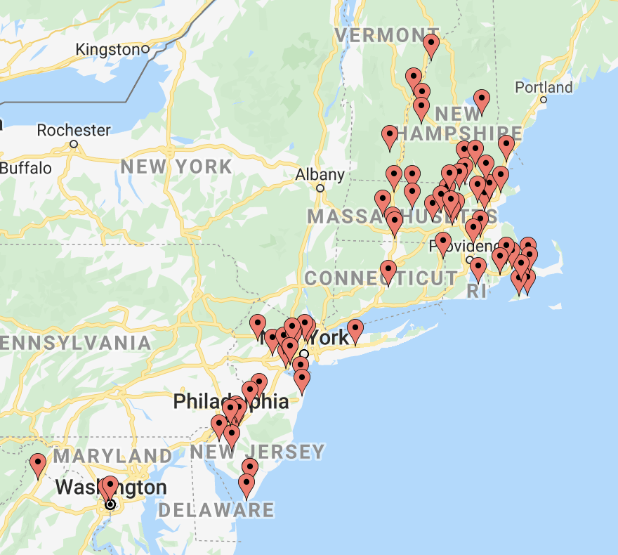
PowerSchool Clients Worldwide
Districts
160 USA
6 Asia
3 Europe
2 Canada
1 Southeast Asia
3 Caribbean
and thousands
of
Standard-Based
Report Cards

Slide 7


Who are you?
Traditional or Standards Grades?
  Teachers have graded
  Teachers will be grading
  Selection Process?
  Special Needs/GIFTED/ELL Students
  Modified Curriculum
  Gradebook PowerTeacherPro
  Start Date- This year?
  Hybrid Anyone ( Traditional and Standards)

Slide 8

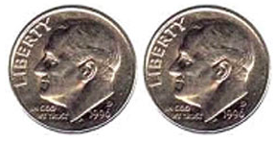
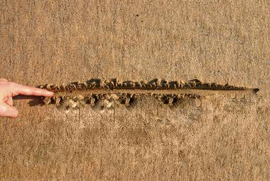
CURRICULUM/ADMIN & TECHNICAL
SHIFT
Go slow to get it right!
DRAW A LINE IN THE SAND
Collaborate and learn the constraints

Slide 9







Implementation Signs
WHY
WHY
WHAT
WHAT

Slide 10












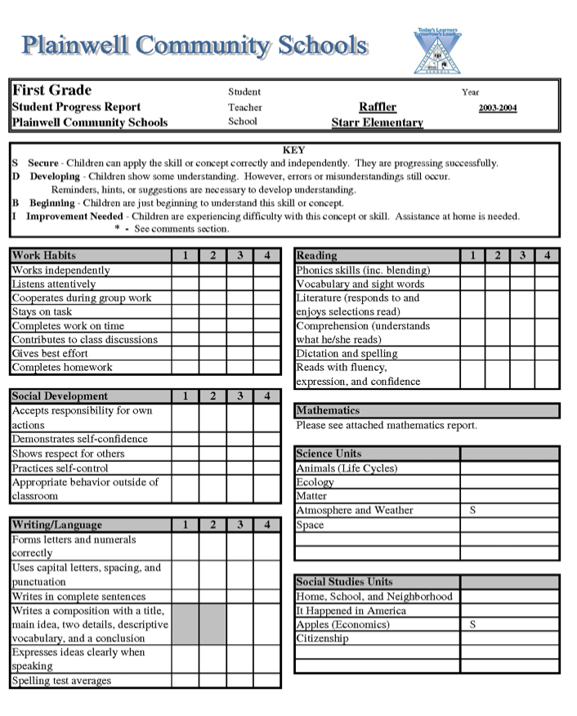
Standard Resources
ELA 2
71
MA 2
28
As written or “word smith “School Speak” out of them
All of them
or some of them?
CAREFUL

Slide 11
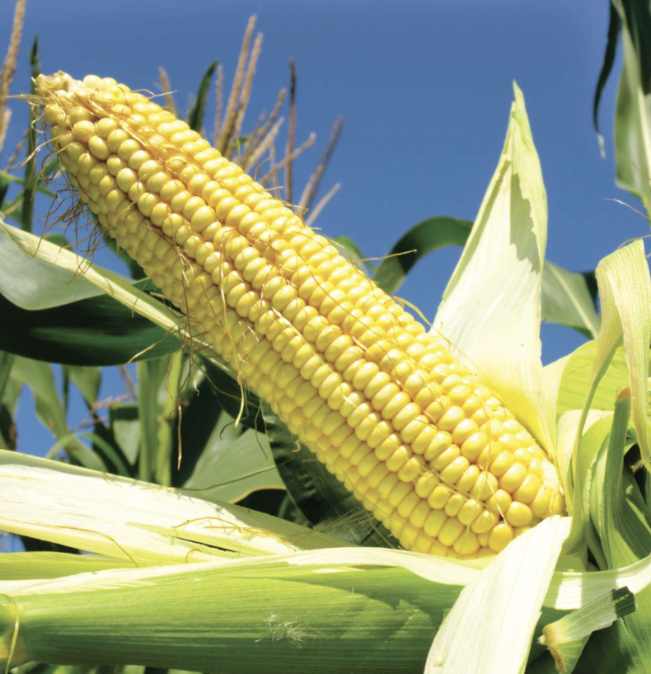


Most Common Mistakes
TIME: Insufficient professional development in the transition from traditional to standard grades
Too many standards negatively impacts differentiated instruction, re-teaching and grades with little to no evidence

Slide 12

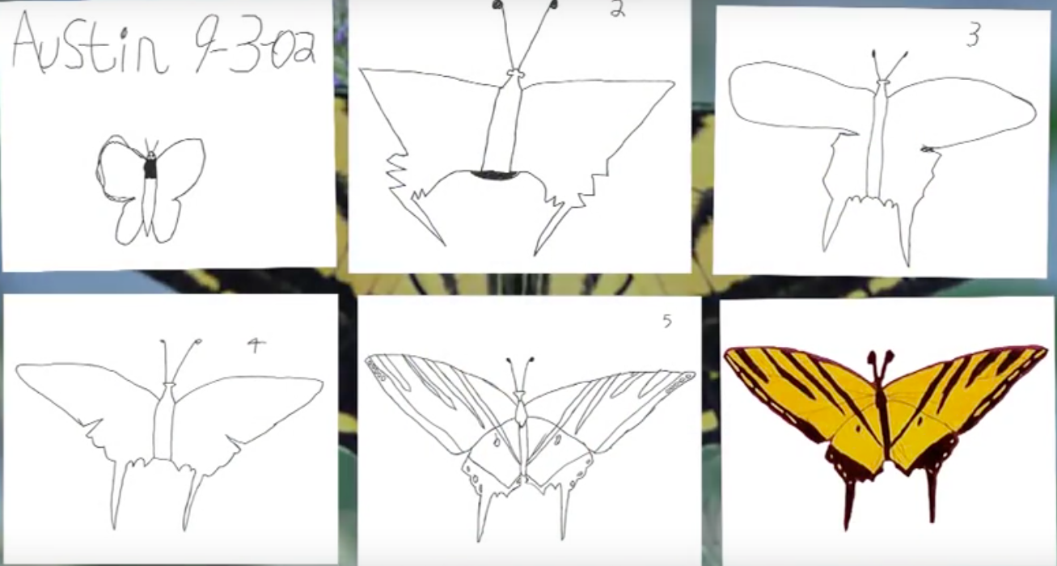
AUSTIN’S BUTTERFLY
Featuring Ron Berger from Expeditionary Learning.
Produced by David Grant (www.elschools.org)
Next Faculty
Meeting
https://www.youtube.com/watch?v=hqh1MRWZjms

Slide 13

Essential Question #1
What is the Primary purpose of classroom assessments?
Think about it for a moment!
What students do, what students know,
how students think,
sort and select students and to justify
and provide evidence to support grades
STUDENTS
YOU
INFORM TEACHING and IMPROVE LEARNING

Slide 14

Strong Leadership is a must!
Focusing on the WHY
Communication with stakeholders
Looking at assessments/grading changes
  Creating rubrics
Selection of standards with guidelines/timelines
Advancement/retention policies with standards
Professional development for all and new staff
  Data analysis once scoring begins!
Provide adequate time for the transition from traditional grades to standard grades (6-24 months)
INCLUDE Technology Department
  Creation of the SBRC- feedback
  Decisions on work-arounds
Skipping these steps will result in at best - continuous revisions and most often FAILURE!

Slide 15
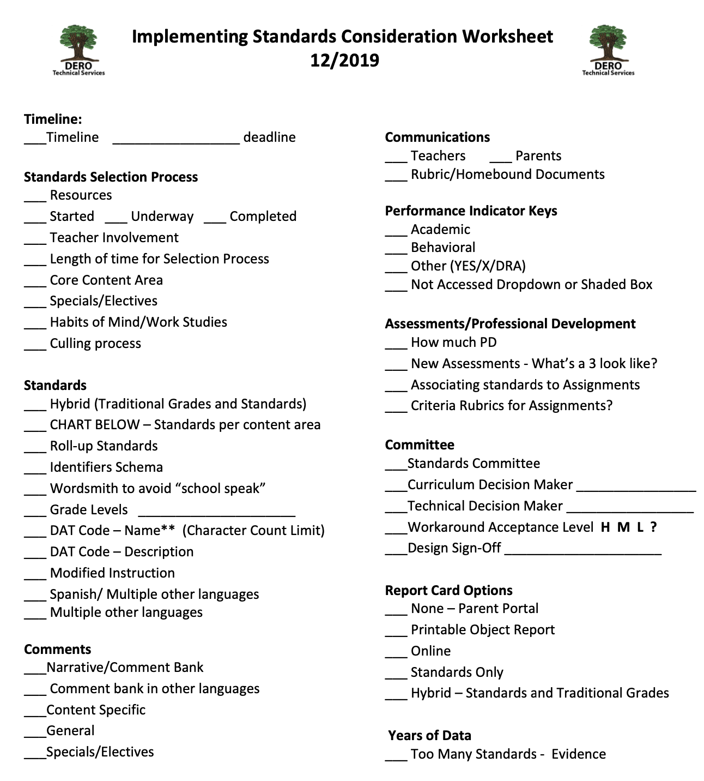
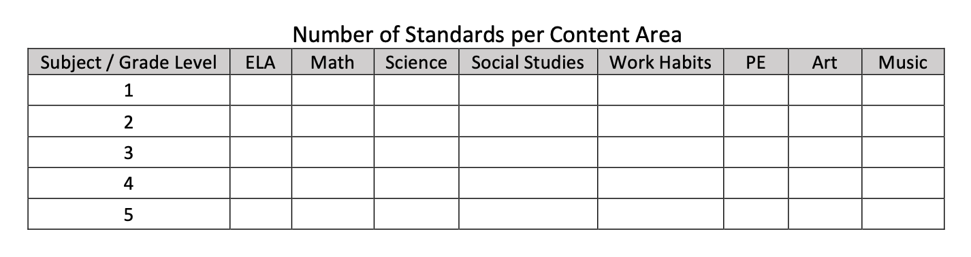
Standards Worksheet http://www.derotechnical.com/STANDARDS

Slide 16
Selecting Your Standards
Grade level teacher Team* - Pilot concerns
Discussions vs. Disagreements – STRONG ADMIN LEADERSHIP
Set guidelines - # of standards per content area per grade level including Life Skills/Work Habits/Successful Skills for Learning
Different Student Groups _ GIFTED, Special Education, ELL
Benchmark Dates – 1st Draft per content area
Compare Standards # by Content by Grade Level
Create a Roadmap with Benchmarks
SET/KEEP* FINAL DATE – No more changes after…
IF YOU BUILD IT, THEY WILL COME– Changes before EOY
Final Standards must be PARENT FRIENDLY- AVOID educational jargon!
Make chart of total standards/1st check for vertical articulation
 | PreK | K | 1 | 2 | 3 | 4 | 5
ELA | 15 | 12 | 18 | 10 | 17 | 23 | 32
MA | 12 | 6 | 12 | 13 | 13 | 14 | 14
SCI | 2 | 2 | 3 | 14 | 3 | 3 | 4

Slide 17
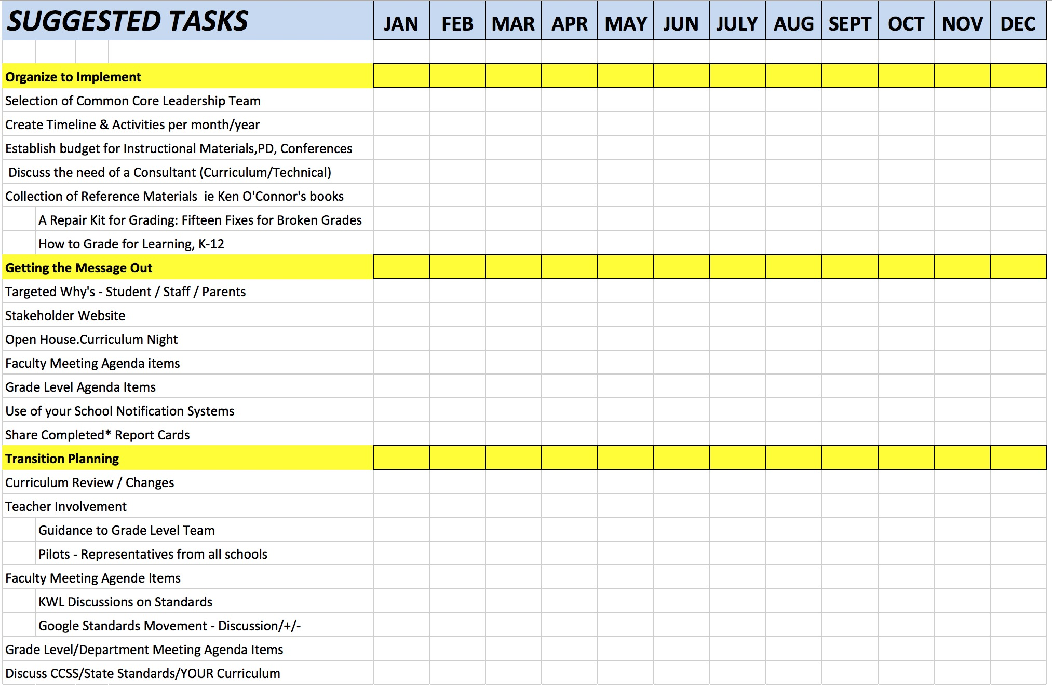
Suggested Tasks and Benchmarks
SAMPLE
http://www.derotechnical.com/STANDARDS/Standards.html

Slide 18


Delicate Balance
Too Little Time to
Teach and/or Re-Teach
Too Many Standards
Will your teachers have enough time to teach all these standards?
Will your teachers be able to attach these standards to assignments?
What is PD has been planned after standards are selected?
(Subject Area, Grade Level, School and District)
The Forgotten Element of Instructional Leadership: Grading
Thomas Guskey and Laura Link

Slide 19
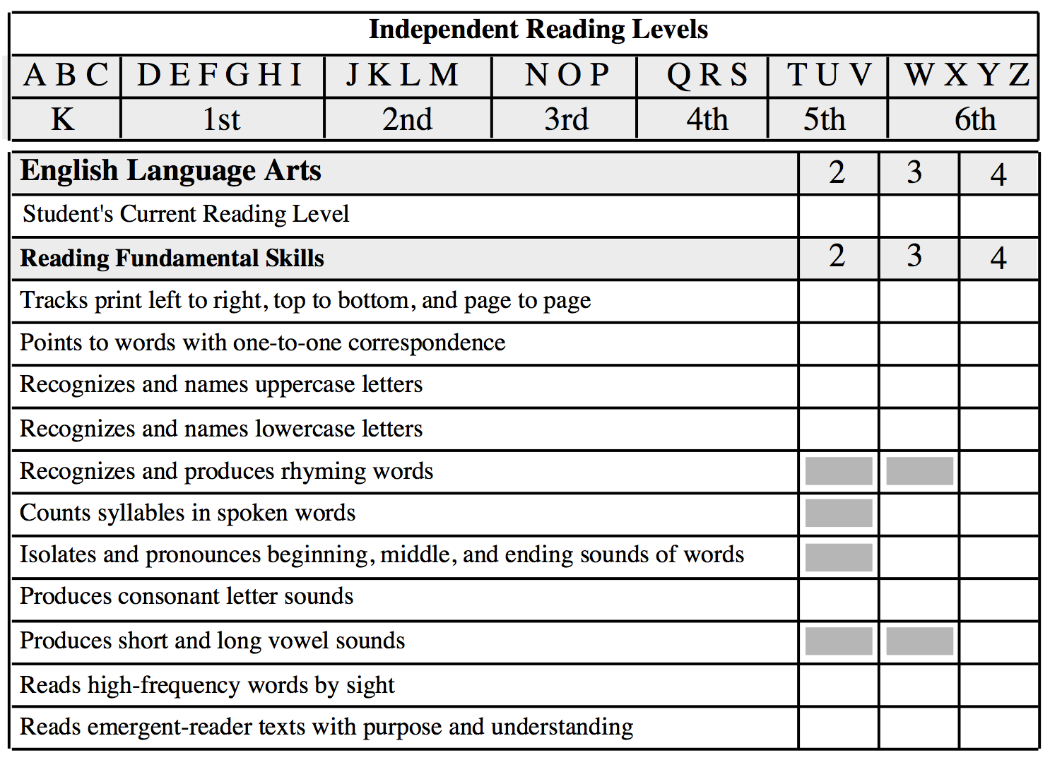
O
U
O
O
O
Wisconsin Parent...
“Now that I know what standard my daughter is struggling with, I hope I can understand what the standard means?”
This is more evidence for districts to wordsmith all standards removing the “school speak” language!
S
O
O

Slide 20
? Related Subjects/Specials ?
What I have seen and continue to see…
More focus on ELA – MA – BEHAVIORAL – SCI – SOC
Focus on Core & Behavior - Participation grades
General standards – not grade specific
Specialist Rosters – Entire Elementary Schools # of students
Specialist – Masters of the Fill Down
Very few clients ask for Specialist Comments
New Treads:
  3-5 total standards for all specials
  Academic Performance per content area not grade level
  Behavior Standards ( eliminates the need for a comment)
  BS standards - same of all related subjects, selected from those for core academic subjects

Slide 21
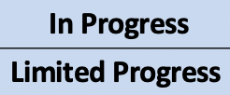

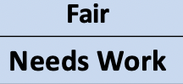
Grade Scales for Standards
A | B | C | D | E/F
4 | 3 | 2 | 1 | 0
Proficient | Developing | Beginning | NY = Not Yet
Advanced | Meets | Developing | Unacceptable
Exceeds | Target | Approaches | FFB = Falls Far Below | SC – See Comment
Mastery | Effective | Acceptable | Developing
EXemplary | Proficient | Developing | Emerging | No Grade
EXceptional | ABove Exception | Satisfactory | BElow Expectation | Unsatisfactory
Outstanding | Satisfactory | Unsatisfactory | Needs Improvement
Consistently | Usually | Often | Infrequently
What will you use?

Slide 22
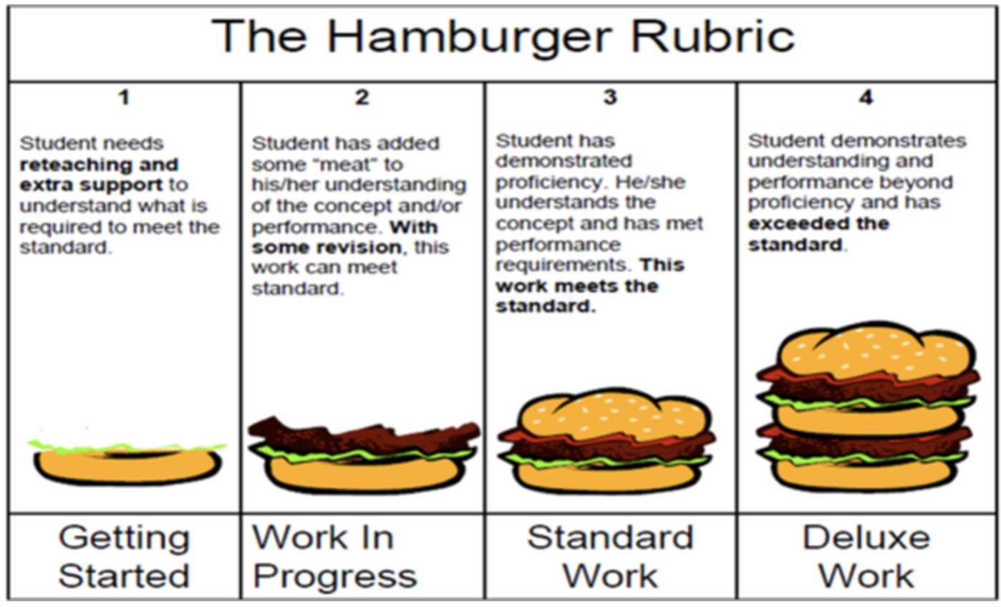
Understanding a Grading Rubric
Huntsville City Schools, Alabama &
many others
Pizza Rubrics can work too!

Slide 23
Assessment/Assignment Rubric
Rubric templates and examples exist all over the Internet, or simply ask colleagues if they have developed rubrics for similar assignments. This would be an EXCELLENT grade level or faculty meeting agenda item!
The Process
Select an assignment for your course - ideally one that all teachers in a grade level will need to assess and provide feedback on to administration.
Decide what you want students to demonstrate about their learning through that assignment. These are your criteria. One assessment can have multiple criterias!
Develop the markers of quality on which you feel comfortable evaluating students’ level of learning - often along with your grade scale. (i.e., "excellent-4," “meets=3,” ”approaching -2”, "fair-1," "poor-0"; or, "Mastery," "Emerging," "Beginning" for a developmental approach)
Give students the rubric ahead of time. Advise them to use it in guiding their completion of the assignment.
This is important but time consuming work,
please do not require this on all assessments!

Slide 24
Blank Rubric – Assignment Name
or your values
Rubric Criteria | 4 | 3 | 2 | 1 | Student Score
Criteria 1
Criteria 2
Criteria 3
Criteria 4
Criteria 5
What do students need to know or demonstrate to achieve these scores
How many criteria will this assignment cover?
Activity for grade level specific common assessments for teachers
Once students have an understanding of their grade scale, students can help their teachers create this rubric possibly assessing their own progress in each criteria!

Slide 25
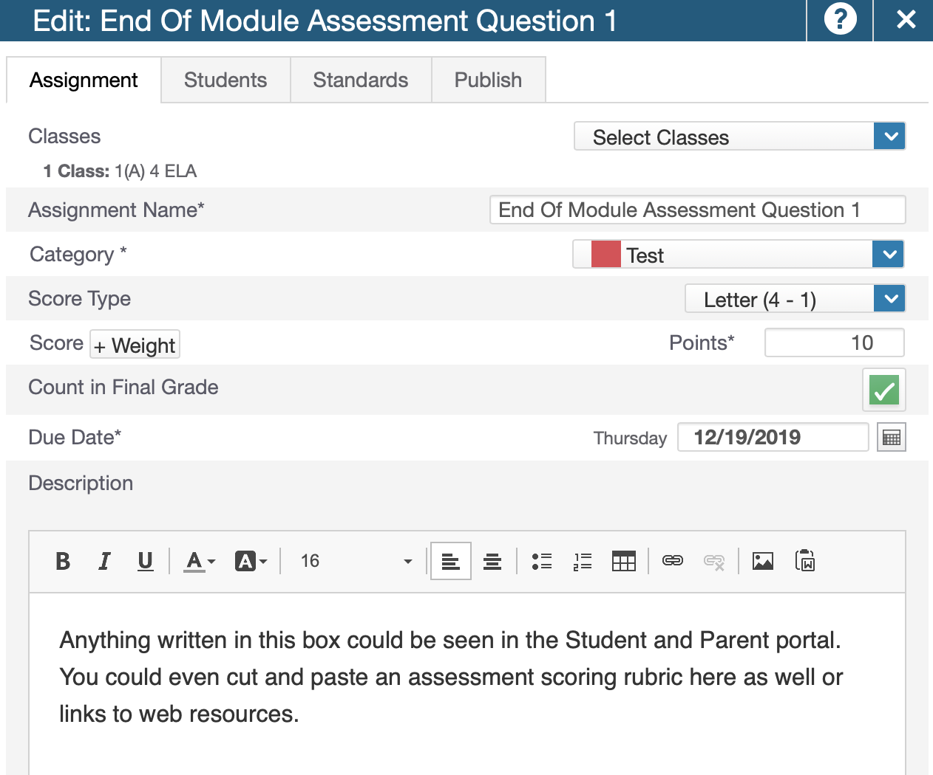
The Power of Feedback
Electronic/Handwritten/Verbal
Hopefully without mandates your teachers have been providing written & verbal feedback for years!
When a waitress/waiter writes a personal note on the bill or napkin, you are most likely to leave a larger tip!
1. PTP allows teachers to enter a description when creating an assignment.
2. Don’t make this a mandate or it might backfire on you!
3. Can be see through the portal by students and guardians!
4. Some districts are moving towards feedback only – no grades on specific assessments
Thomas R. Guskey
http://kappanonline.org/grades-versus-comments-research

Slide 26
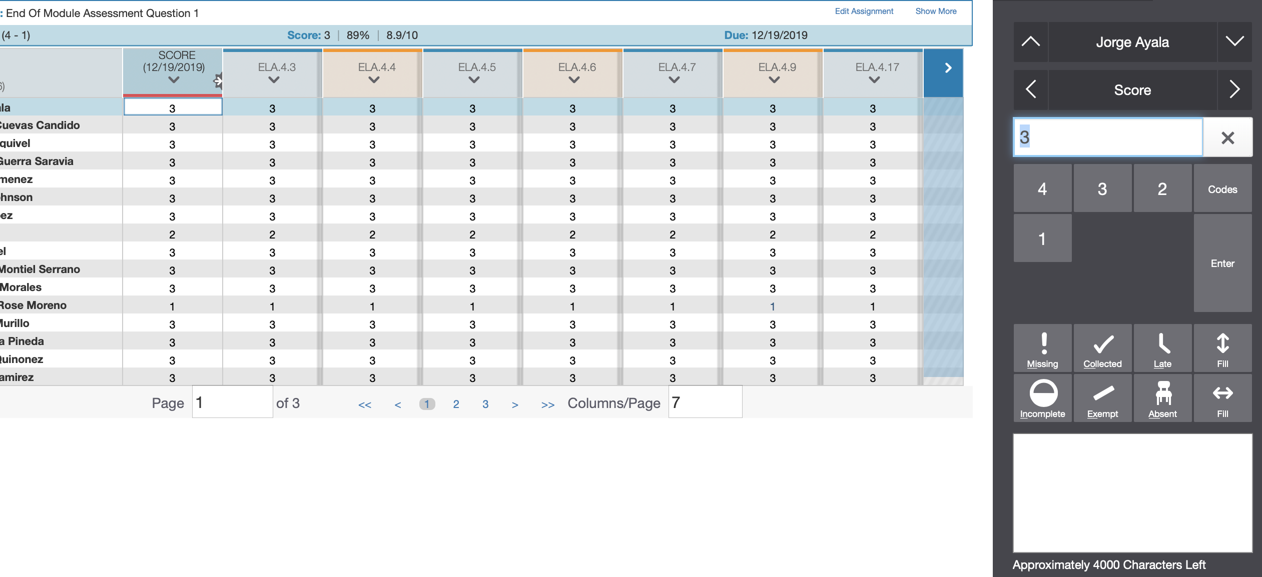
The Power of Feedback
Electronic via PowerTeacherPro
While scoring or afterwards, teachers can select an assignment score and enter a comment which can be viewed through the portal for students and/or guardians.
NORMALLY – I recommend not allowing standards to have comments for a variety of reasons.
http://kappanonline.org/grades-versus-comments-research

Slide 27
Change requires continual checking of your stakeholders temperature.
HAS THIS HAPPENED YET?
Parents
Teachers
Tech Team
Can you imagine a time when parent changes from saying: You’re going to have to try harder to what strategies/resources can you use to master this standard?

Slide 28
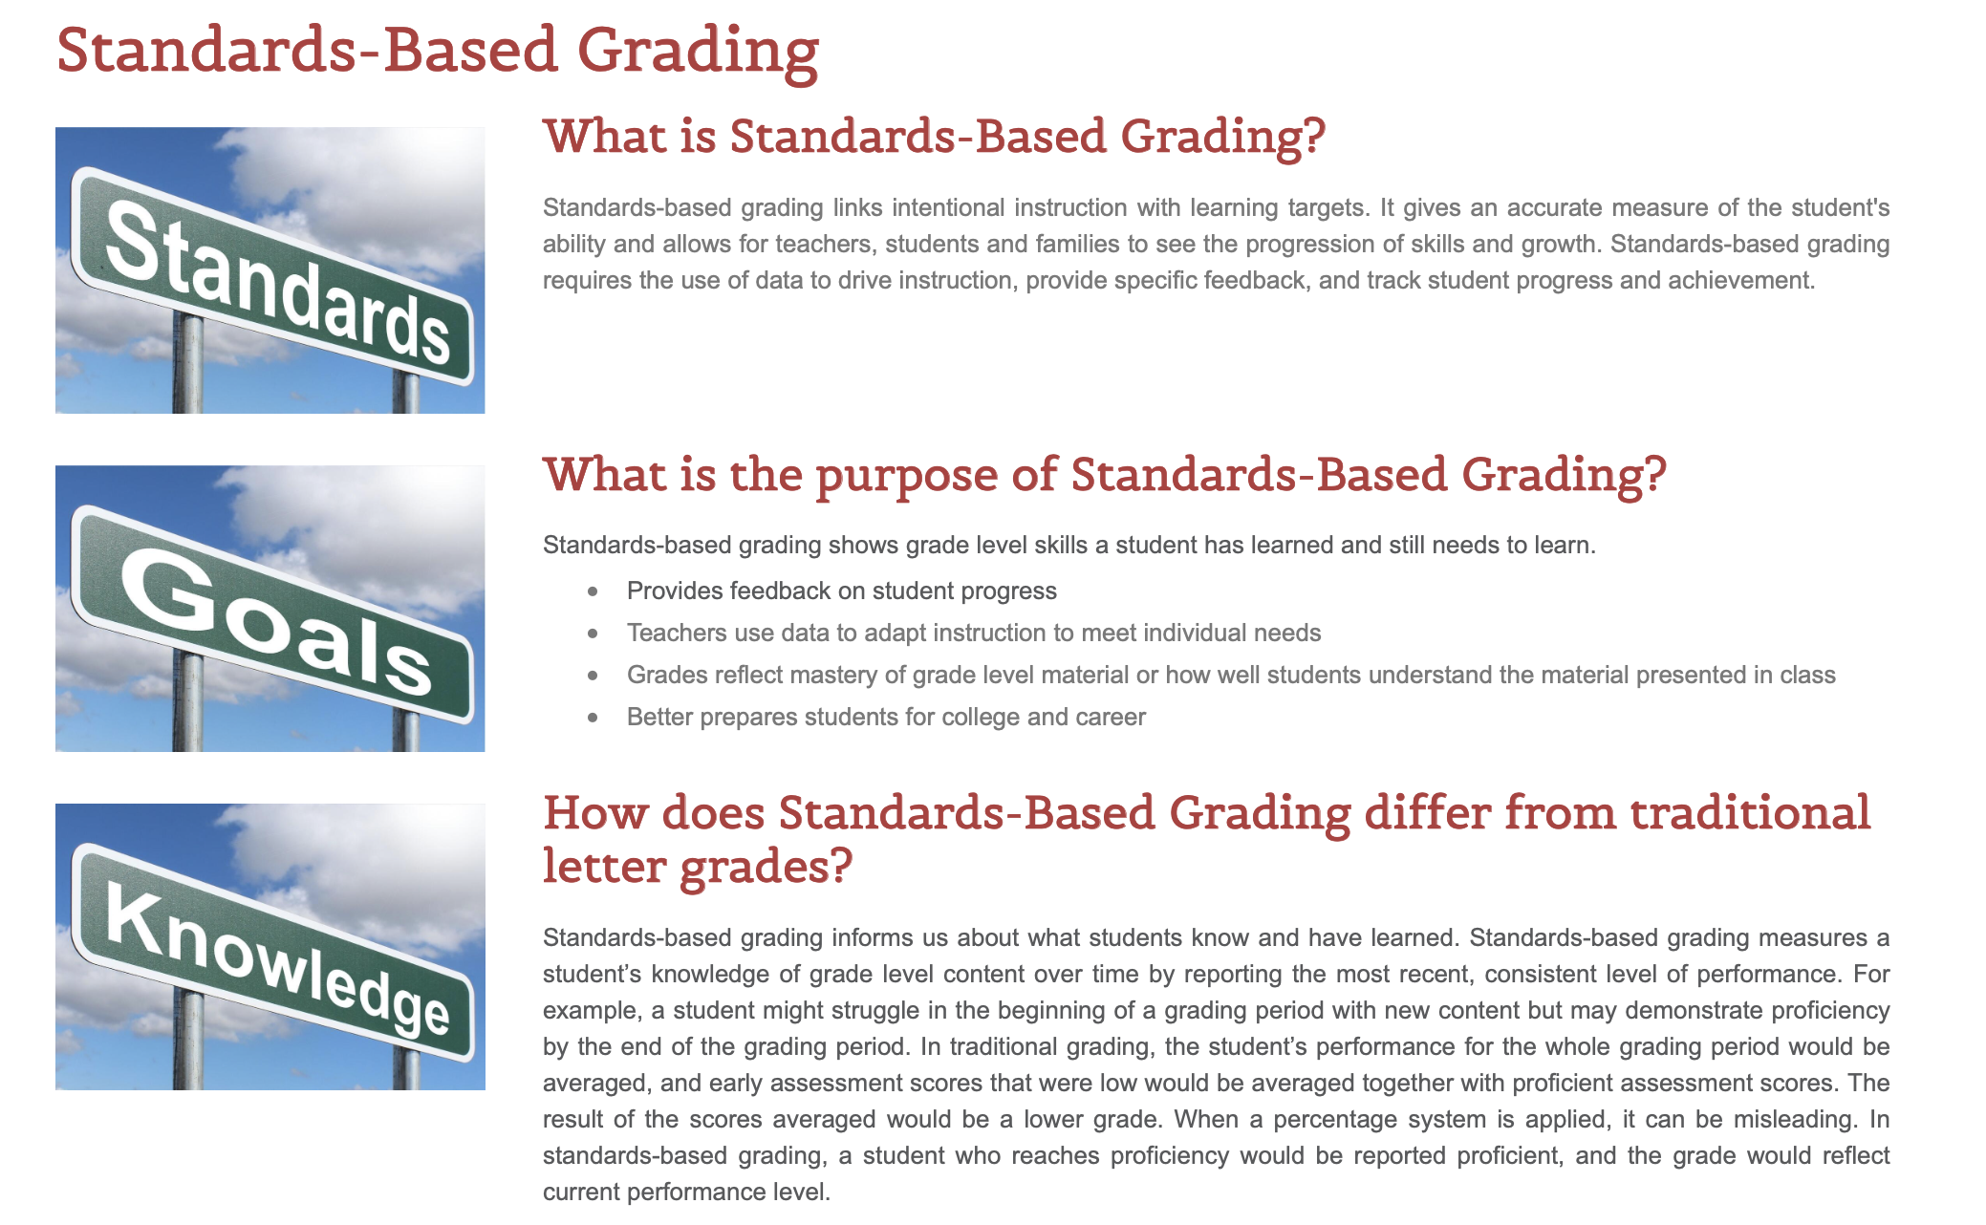

Communicating Change is Coming!
Ruth B. Uecker, Assistant Superintendent
Great Falls Public Schools, Montana

Slide 29



Read anything by Ken O’Connor aka The Grade Doctor
C
Far more important than the grade is how the district has trained teachers in the proper techniques in determining that grade. PowerTeacherPro has been designed with many of Ken O’Connor’s principles.
Evidence
MISSING WORK
TENDENCY
Learning Conversations:
The Culture of Grading
Have you had these chats yet?
MAKE UP WORK
EXTRA CREDIT
HOPE
ZERO’s

Slide 30

High Recommended - Standard Based Learning FB Page
Ken O’Connor is a frequent contributor to this page
Searchable by content areas as well… nice feature
https://www.facebook.com/groups/standardsbasedlearningandgrading/

Slide 31
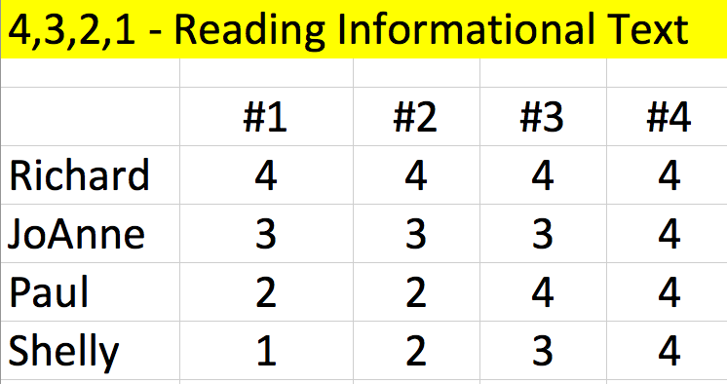
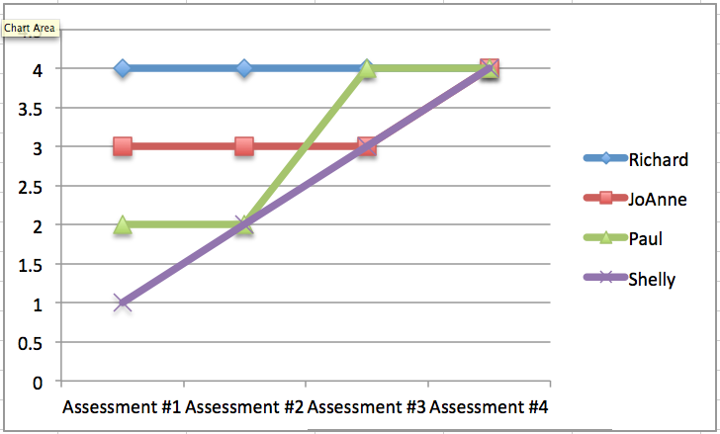

GRADING PRACTICES
Fix #14 – Tendency vs Average
The most recent
score for all
is a 4!
If at first you don’t succeed,
skydiving may not be for you!
Tendency
Trends
Average
Mastery

Slide 32


Your Conversion Scale has been set… now what does a 4 or a C really mean?
C
With teachers at your Grade Level
With teachers at your School
With teachers in the District
What does it mean for next placement?
How are Special Needs students graded?
What do students need to know and
be able to demonstrate?
Everyone on the Same Page

Slide 33
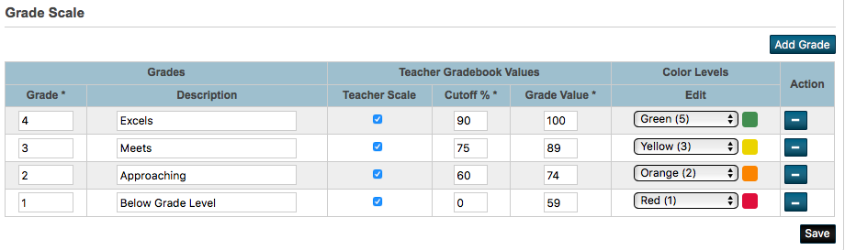
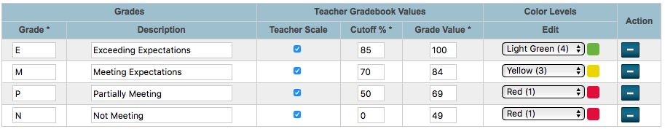
Grade Scales
Courses use Grade Scales – Assignments, Standards use Grade Scales
4 = 90-100, 3 = 75-89, 2 = 60=74, 1 = 0-59
E = 85-100, M = 70-84, P = 50=69, N = 0-49
Technical Note - 8 Character Limit

Slide 34

Homebound Assessment
C
Avoid Confusion- Adjust Rubrics and assessments
Sending Home Letter Grades and Percentages will confuse Parents and Students
How does an
A-, B+, 93, 82, B-
EQUAL a 3?

Slide 35





Additional Considerations
STRONG CURRICULUM LEADERSHIP IS A MUST!
Pilots - Where do you start
K-4
1-5
6-8
5-8
K-8
Best pilots – single grade level at all schools rather than only one school providing IN HOUSE EXPERIENCE!
PK K 1 2 3 4 5 6 7 8 9 -12 Parent and Student acceptance
9-12
Prerequisites & Placement
K-12 Retention, GPA, Class Rank & Honor Roll Policies

Slide 36
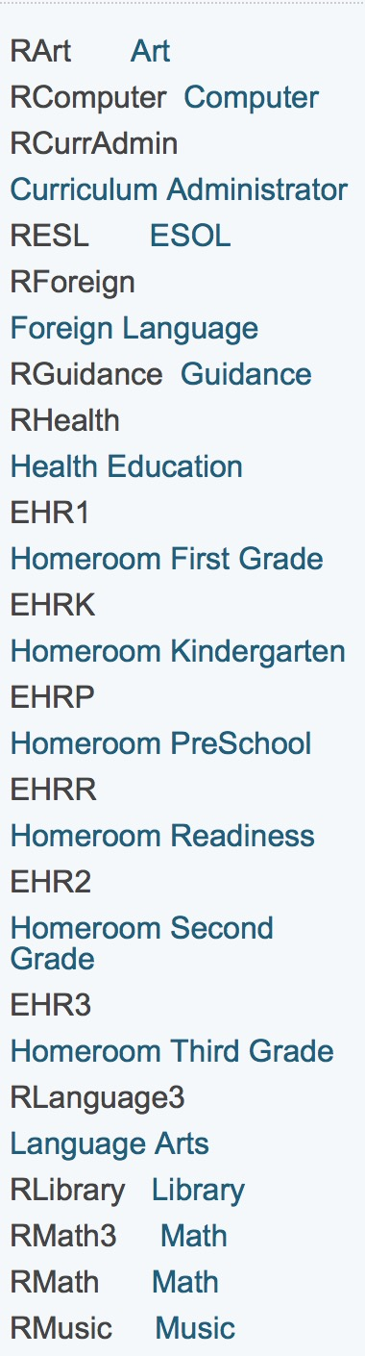
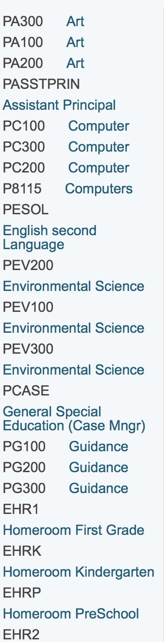
Standards associated to Courses
School 1
School 2
ASSUMING
300-200-100 REPRESENTS
GRADES 3,2,1
WHAT CAN SCHOOL 2 DO THE SCHOOL 1 CAN’T??
GRADE LEVEL SPECIFIC STANDARDS
CAN’T BE TIED TO A COURSE # SERVING MULTIPLE GRADES
ARE SPECIAL EDUCATION
TEACHERS GRADING THE SAME STANDARDS????
MOST PULL OUT SPED COURSES
aren’t grade level specific

Slide 37
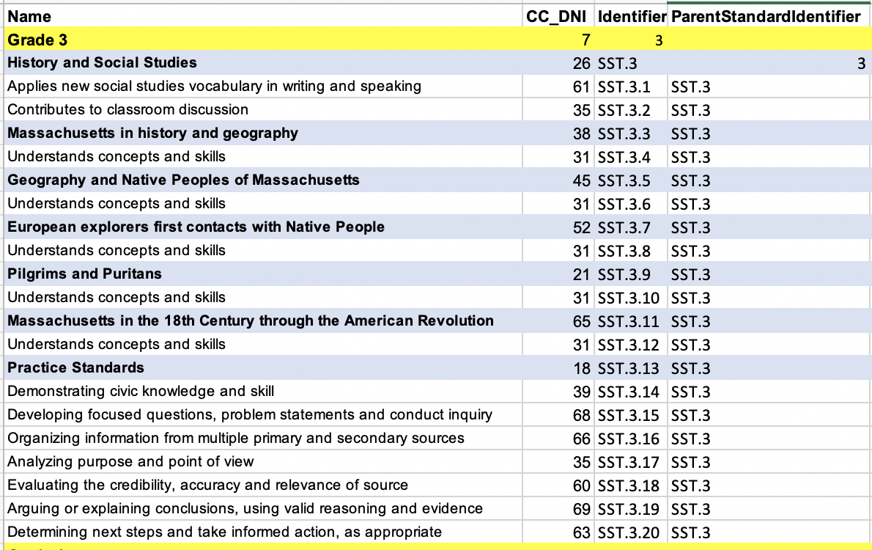
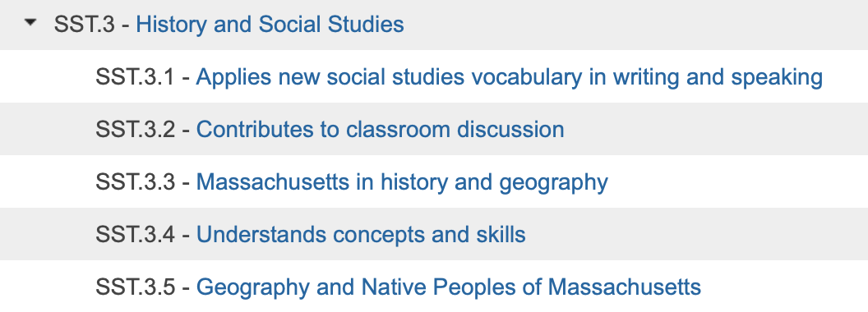
Standard Important Template

Slide 38
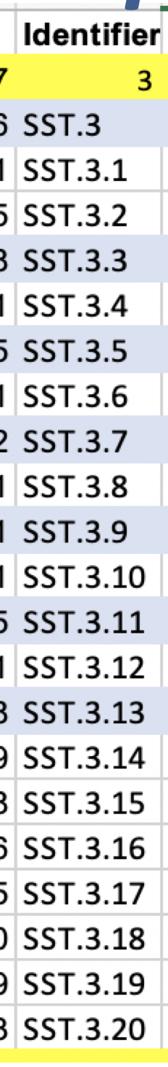
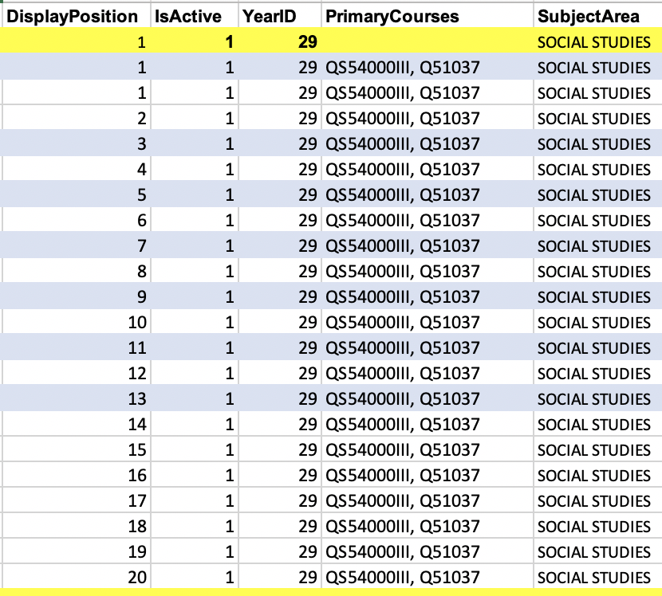
Standard Important Template
USUALLY the DISPLAY POSITION #
MATCHES the
LAST DIGIT in the Identifier
Comma separated course # if standard applies to one or more course!

Slide 39
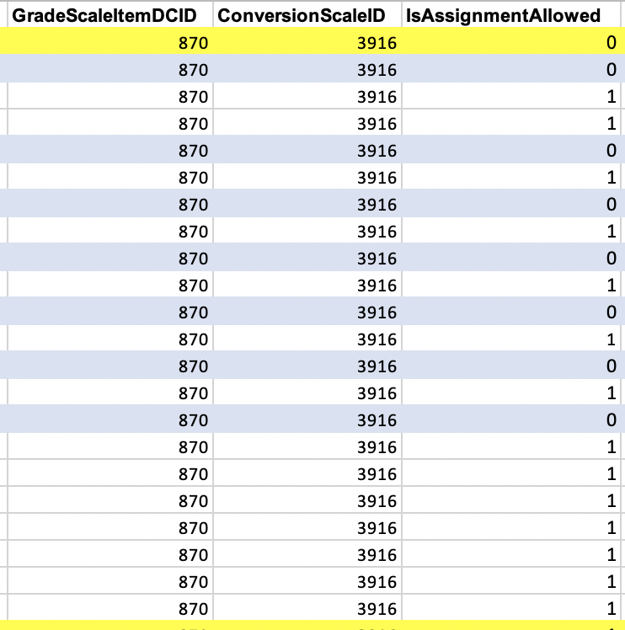

Standard Important Template
5/6/22
PS SIS 22.5
PS Insider
#118
0 = not shown in gradebook
1 = shown in gradebook and allows grade entry
(if 870 or 3916 has values)
PTP PTG

Slide 40
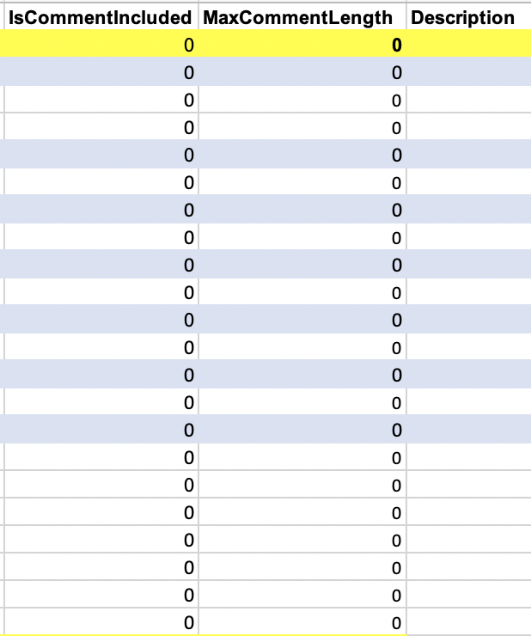
Standard Important Template
NORMALLY,
Teachers shouldn’t comment on individual standards (0)
UNLESS
A teacher comment has been created (1)

Slide 41
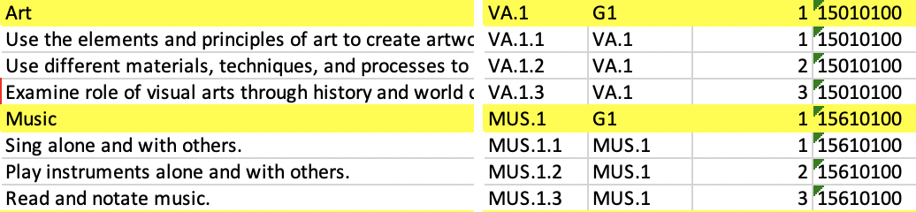
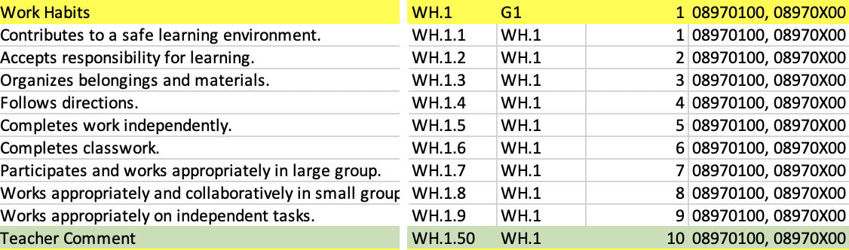
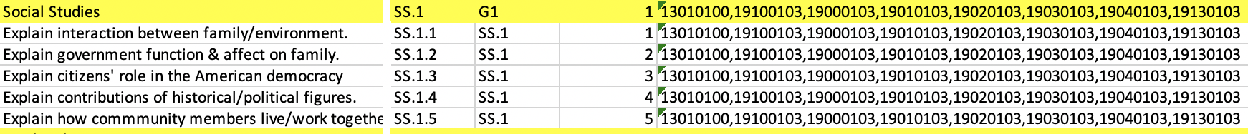
Standards associated to PrimaryCourses
Name
Identifier
1
ParentStandardIdentifier
2
PrimaryCourses
6

Slide 42
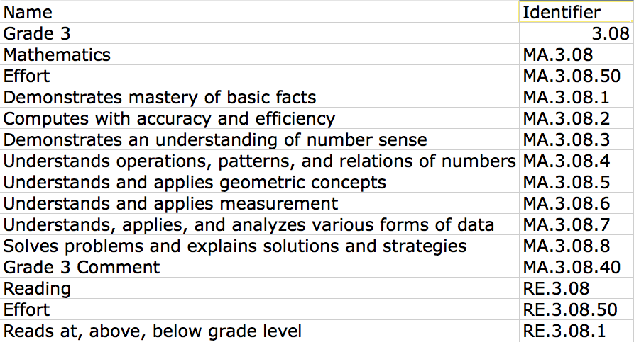
UNIQUE IDENTIFIER FOR EACH STANDARDS
Do your teachers need to know these identifiers??

Slide 43
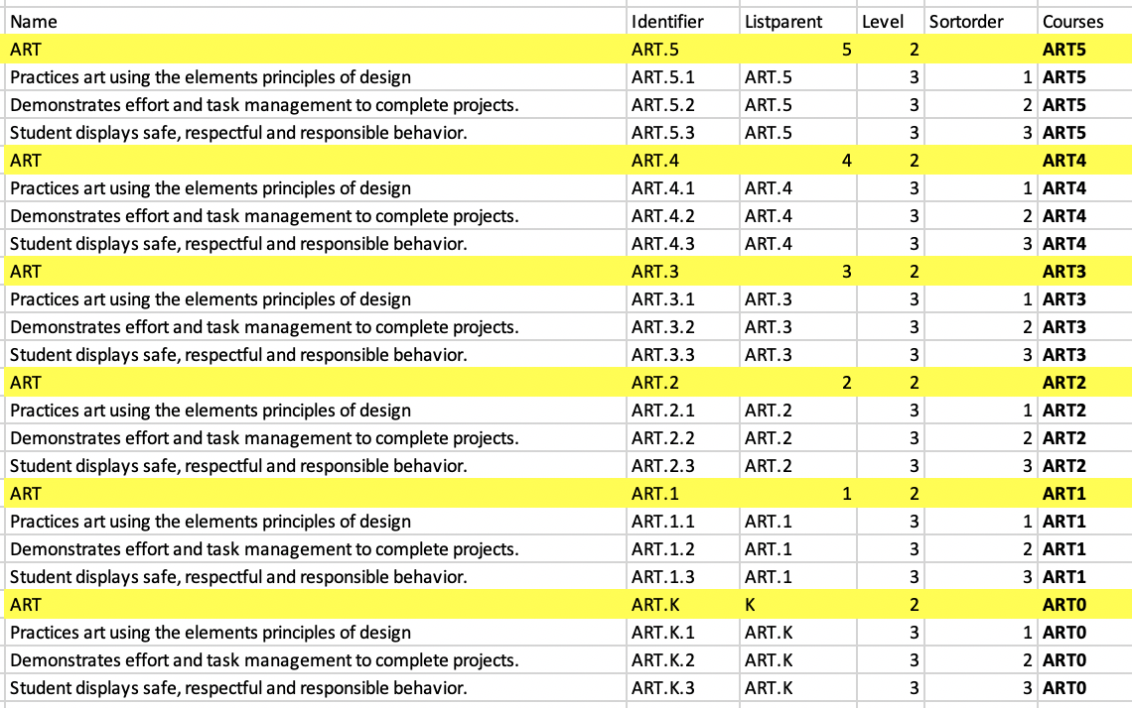
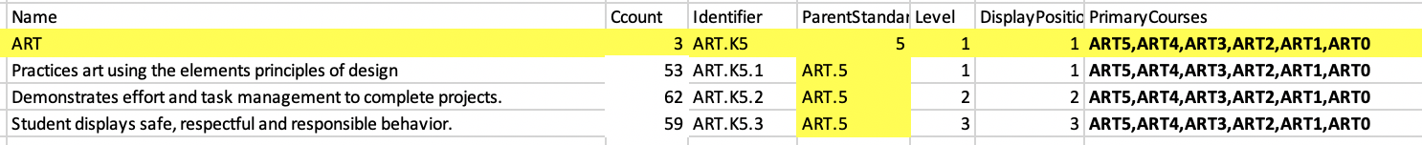
Standards Associated to Multiple Grades
1. Standards in the core academic courses are usually Grade specific
2. Often electives initially start with more generic standards that can be applied to all grades in an elementary school
Due in part to the amount of time allocated to core
As well as the number of sections a specialist has
The frequency of a specialist using the gradebook
3. Options: Enter standards for each grade level or enter them once for all grade levels and course numbers
ART.K5.X
An added benefit to similar standards for multiple grades is that when you create a printable report card, the standard grid in this particular example (ART) need only be created once as it can be used in Grades K-5

Slide 44
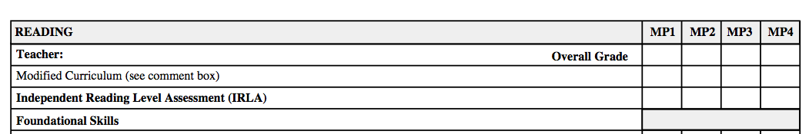
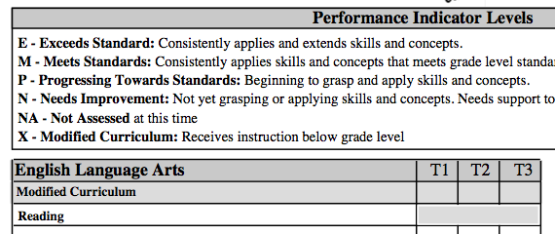
DELIMMA
Special Needs Students/Teachers
HOW
In SC there are multiple levels of Special Education services some districts may require up to 8 course #’s
10010100,19100100,19000100,19010100,19020100,19030100,19040100,19130100

Slide 45
What does FINAL version mean?
WHAT
DO YOU MEAN IF
I CHANGE STANDARDS
DURING THE YEAR I CAN’T
RE-USE
THE UNIQUE IDENTIFIERS!!
DO I HAVE TO CHANGE
ALL MY REPORT
CARDS?
Make sure FINAL really means FINAL
When do you import the standards or new standards?
No More Changes for 1 year!!
Send and Save email to curriculum –
“Are you planning any changes to the standards?”
NO

Slide 46

When do retire standards?
Migrate current standards to next year, tweak standards in the next year.
How do you retire standards? (ZOLD & remove course association)
Why did you retire standards?
What happens if you decided to retire standards after EOY?
Lots of Standards Resources can be found @
www.derotechnical.com

Slide 47
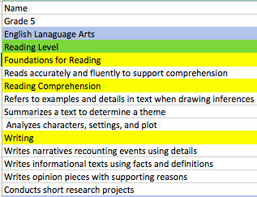
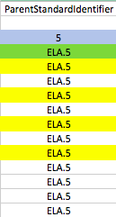



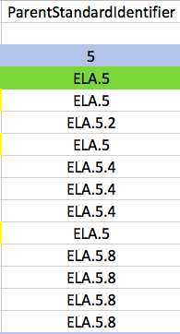
Standard Import Template
When do you import the standards?
Samples can be found on my website
http://www.derotechnical.com/STANDARDS/CharacterCount.html

Slide 48

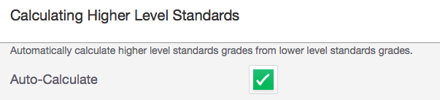
DECISION TIME ROLL-UP Grades or Not
Gradebook Preferences:
Calculate Higher Level Standards
SELDOM REQUESTED ANYMORE
PowerTeacher Pro

Slide 49
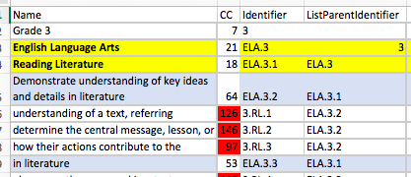
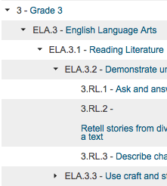
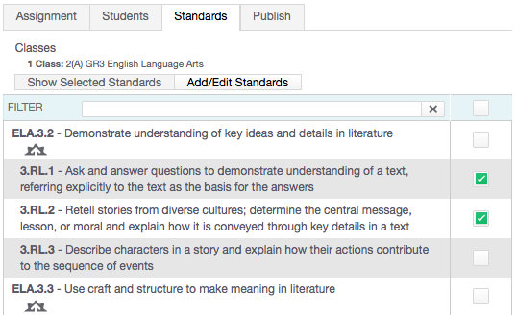
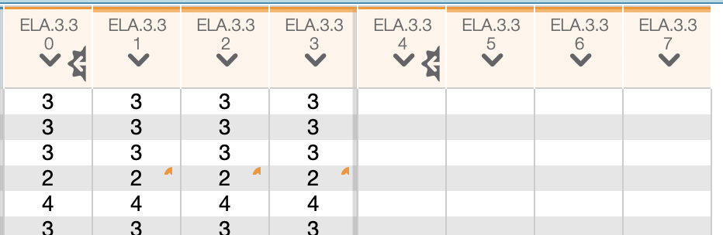
ListParentIdentifier - Rollup
ListParentIdentifier – places “child” standards under their parents

Slide 50

PS 22.5 Limiting Parent Standards
BobC – “NEVER select the Crown”

Slide 51
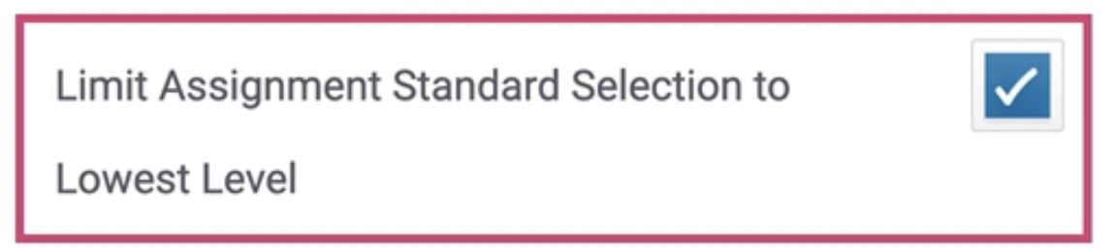
PS 22.5 Limiting Parent Standards
BobC – “NEVER select the Crown”
PS Insider Episode # 118

Slide 52
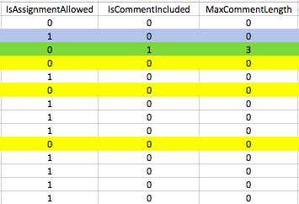


Standard Import Template
If your district wanted to roll-up child standards scores to
auto-calculate the parent standards scores many columns
would have to change. 50% of teachers report that they
over-write the calculated grades.

Slide 53


Display Position
CCMA.4
CCMA.4.1
CCMA.4.4
DO NOT SHOW IN THE GRADEBOOK!
WHY?

Slide 54

What to show in the PTP?
CELA.4.2
CELA.4.3
CELA.4.4
CELA.4.5
CELA.4.6
CELA.4.7
CELA.4.8
CELA.4.9

Slide 55




Need Spanish or “one” other language too?
If aren’t using the description field for anything – longer full standard name/identifier – you could use that field for Spanish description
Standard Name = English
A session on ParkBench Visual PST follows this session

Slide 56

Need Spanish or “one” other language too?
Standard Name + Standard Description = BOTH
Standard Description = Spanish
Park Bench Visual PST – VERSION 3

Slide 57



Additional Thoughts on Comments
Create a standard called
Teacher Comment associate to HR or
Subject Comment to Subject
How do you set the correct length?
When you create an entry box on your report card use the same sized box for all grades all subjects. Content specific comments are NORMALLY shorter than a summative narrative

Slide 58


Importing via
Data Import Manager
Original spreadsheet
Can’t be re-imported as you will ID and Longitudinal ID
Use all the fields – JUST EASIER
ID must be used when re-importing**

Slide 59


RE-IMPORTING ISSUES
The process of importing standards CREATES TWO FIELDS IN YELLOW
IF CHANGES – export standards including ID and LongitudinalID
Sort – change and re-import

Slide 60

Standards have to be managed
YEAR TO YEAR/EOY or...
MUST SET UP AT THE DISTRICT LEVEL 2021-2022
YOU MUST THEN BE IN CURRENT YEAR
CREATE STANDARDS LIST for YearID 32 (next year)
Create Next Year’s List of Standards Prior to End-of-Year
√ 24,012 standards were created for 2017-2018
COPIES ALL CURRENT YEAR STANDARDS – ACTIVE AND INACTIVE
EOY PROCESS WILL NOT COPY OVER STANDARDS - IN ADVANCE!
IF YOU CHANGE STANDARDS AFTER CREATING….????

Slide 61



Have you thought about Report Cards?
Parent Portal – access to grades – list form
NOT DYNAMIC – all must be custom made
Create on your own or Contract**
Object Reports vs. Online
Summative
Multi-page requires duplex printer
http://www.derotechnical.com/REPORTCARDS/REPORTCARDS.html
** Have the contractor teach you about maintenance!!
Report Creator

Slide 62






Constraints/Decisions
Letter Recognition and Sounds
Post Printing Circles – No Historical Record T2T
Post Printed √ – No Historical Record T2T
IF STANDARDS – 78 standards – Ask Teachers?
Shape/Color and Number Recognition
This picture is stored li1e school
logo’s. JPG
If you choose summative standards for concepts, you may need to provide parents with term
benchmark expectations!

Slide 63

STANDARDS by TERM
Assess it all terms or some terms. GRAY means not assessed in this term!
ParkBench Visual PST V3.1 gives you the ability shade in gray- much easier than creating a single box and duplicating it to fit into another grid box!

Slide 64


Gray Boxes – Disabled Scores (V3.1)
Version 3.1 check a box rather than draw a box!!

Slide 65

25 MINS
All ABOUT
STANDARDS!

Slide 66

Mark Anderson must understand us!!
I can’t this weekend, I’m doing a PowerSchool Administrator Triathlon
Creating new standards in Excel from WORD
Learning to make new grade scales
Building 8 new report cards

Slide 67



Creating Your SBRC??
District Pricing : $395 / year
FREE Demo Licenses are available – send me an email!
get2bobc@gmail.com
If you would like a demo license – email me - get2bobc@gmail

Slide 68

CURRICULUM LEADERSHIP
TECHNICAL TEAM or YOU
Develop Process and Timeline
Establish a team (WITH TECH FOLKS)
Discuss PILOTS for District
Gather Resources
Create Grade Level Teams/Leaders
Plan STAKEHOLDER communications
Review Curriculum and Assessments
Establish/Create the Rubrics/Scales
Discuss Special Ed, GIFTED, ELL Students
Word smith for understanding & shorten
Draft list of STANDARDS in EXCEL not WORD
ELA-MA-Work Habits-SCI-SOC- Specials
Cherry Pick BETTER standards
Review samples of SB report cards
Decided Printable/Online report cards
Word smith for understanding & shorten
Provide FINAL excel to Tech Team
Plan adequate PD for Gradebook Training
Set Faculty/Grade Level Sharing Expectations
Attend Standards Meetings
Review Course Numbers (at each school)
Create Grade Scales once provided
Understand columns standard import files Build Standard Import Template
Send it to BobC – Reviews for FREE**
WHEN FINAL – Import (opt- no primary)
Research Object Reports or Online Options
Create or contract for report card
Create a single grade to PERFECTION
Bring Constraints to Curriculum Team
SIGN-OFF on designed report card
Learn Gradebook even if you aren’t training
Create all report cards/import
Find your early graders!!
ADEQUATE TIME
STANDARD SELECTION PROCESS
CREATION/IMPORT of STANDARD TEMPLATE
REFLECTION
ASSESSMENT/GRADING CHANGES
PROFESSIONAL DEVELOPMENT
CREATION OF THE SBRC
Skipping these steps will result in continuous revisions and most
often FAILURE!

Slide 69
ANY AND ALL DERO RESOURCES ARE AVAILABLE
TO DOWNLOAD, TWEAK and USE FOR YOUR DISTRICT!
Q & A
Bob Cornacchioli
get2bobc@gmail.com
www.derotechnical.com

